Slide 1

EXPENSE TRACKER WITH CATEGORIES
Mini Project
TRAINER : NARASIMHA RAO T

Slide 2
TEAM MEMBERS
Kalpana Meena
Madhur Suresh Rao
Mohammad Rustam
Mohamed Faizan
Nikhil CS
Nikhil Kumar Gupta
Om Jadhav
Pankaj Kumar Rai

Slide 3
MODULE 1
MODULE 2
Expense & Category Management
(Team A - 4 Members)
Mohammad Rustam
Om Jadhav
Nikhil CS
Pankaj Kumar Rai
Analytics, Reports & Performance
(Team B - 4 Members)
Madhur Suresh Rao
Kalpana Meena
Mohammed Faizan
Nikhil Kumar Gupta

Slide 4
RESPONSIBILITIES
MEMBER | TASK
Om Jadhav | Built expense tracking interface with filtering, search, sorting, pagination, and responsive UI components
Nikhil CS | Built the authentication module consisting of a login+signup page, a sidebar logout icon with stored user details as well as the JSON server user services,encrypted the paswords,implemented user authentication in routing and Search Engine Optimization for the application.
Kalpana Meena | Developed the expense summary component to provide a concise overview of financial data. Implemented search functionality and range-based filters on the Reports page for efficient data filtering.
Madhur Suresh Rao | Implemented category-based and date-range filter functionalities. Developed the reports table with sorting capabilities and pagination to enhance data organization and overall user experience.
Mohammed Faizan | Architected and developed the Analytics Dashboard with KPI metrics, and interactive data visualizations using Recharts. Integrated and merged team modules into the final application to ensure seamless functionality.
Mohammad Rustam | Architected the centralized Redux state management system using Redux Toolkit. Implemented Async Thunks for seamless API integration, managed server-side pagination logic, and integrated global theme persistence to ensure data consistency across the application.
Pankaj Kumar Rai | Architected and developed the Category Management module with full CRUD operations, validation logic, and responsive UI integration.
Nikhil Kumar Gupta | Developed the logic of Analytics Dashboard, including filter, KPI calculations, and data aggregations. Optimized computations with useMemo and prepared datasets for Recharts visualizations.

Slide 5
PROBLEM STATEMENT
PROJECT SOLUTION
Users struggle to track personal expenses effectively
No centralized system to organize expenses by categories
Difficult to analyze spending patterns without proper tools
Manual expense tracking is time-consuming and error-prone
Lack of filtering and search capabilities in existing solutions
Web-based Expense Tracker with category management
Key features for users:
o Add, edit, and delete expenses
o Organize expenses by custom categories
o Search expenses with debouncing
o Filter by category and date range
o Sort by amount and date
o View analytics and spending reports
o Responsive UI across all devices

Slide 6
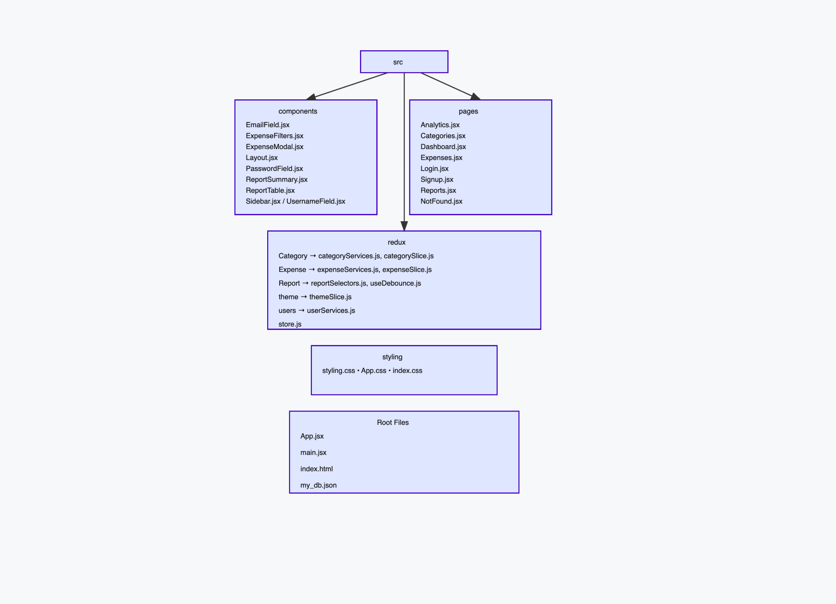
FOLDER STRUCTURE

Slide 7
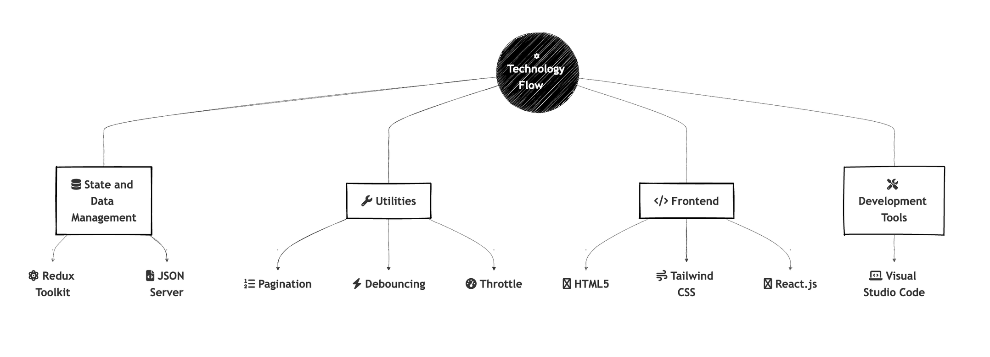
TECH STACK

Slide 8
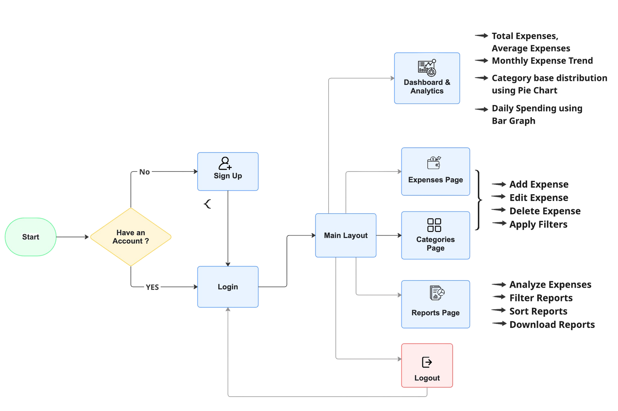
PROJECT FLOW CHART

Slide 9
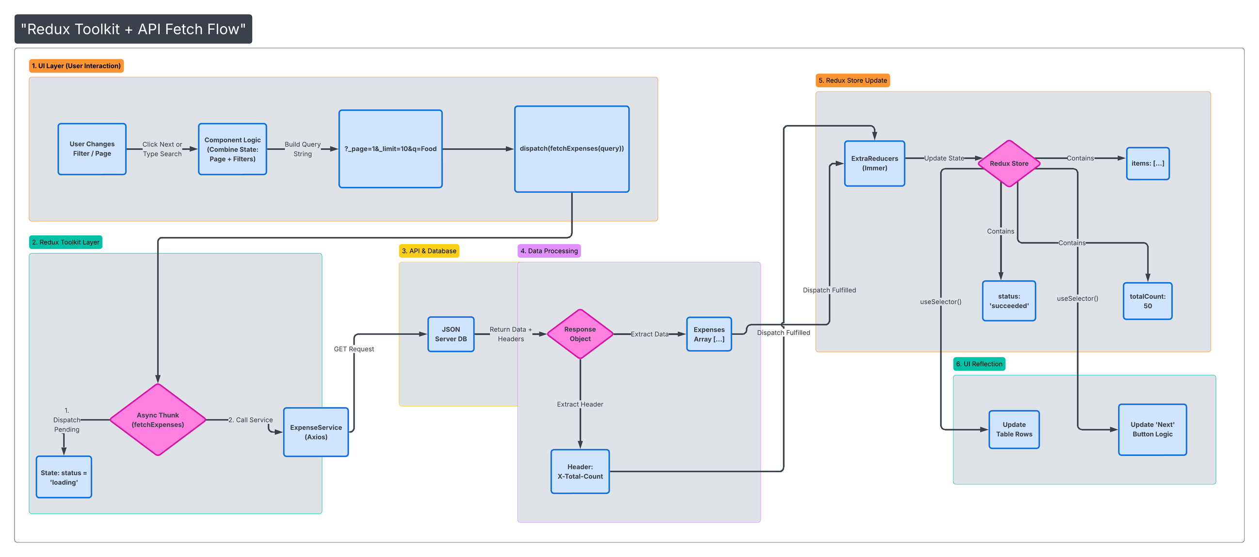
REDUX STATE MANAGEMENT

Slide 10
AUTHENTICATION AND SERVICES
STREAMLINED SIGNUP PROCESS
3-FIELD form (username, email, password) + mandatory 4-picture avatar selection
Eye icon toggles password visibility
Real-time clear and actionable errors
Success automatically saves to database + browser
INTELLIGENT FORM VALIDATION
PRECISE format rules ensure strong username & password standards
Explicit blocking of weak usernames
All checks are case-insensitive
FRICTIONLESS LOGIN EXPERIENCE
AUTO-POPULATES ALL signup details - no retyping needed
Individual field loading with backup screens prevents blank pages
Smooth auto-redirect after successful registration
ROBUST SECURITY & PROTECTION
can't access private pages without login
Encrypted password storage
Graceful error handling - no crashes, always user-friendly
Works perfectly on phones, tablets, and desktops

Slide 11
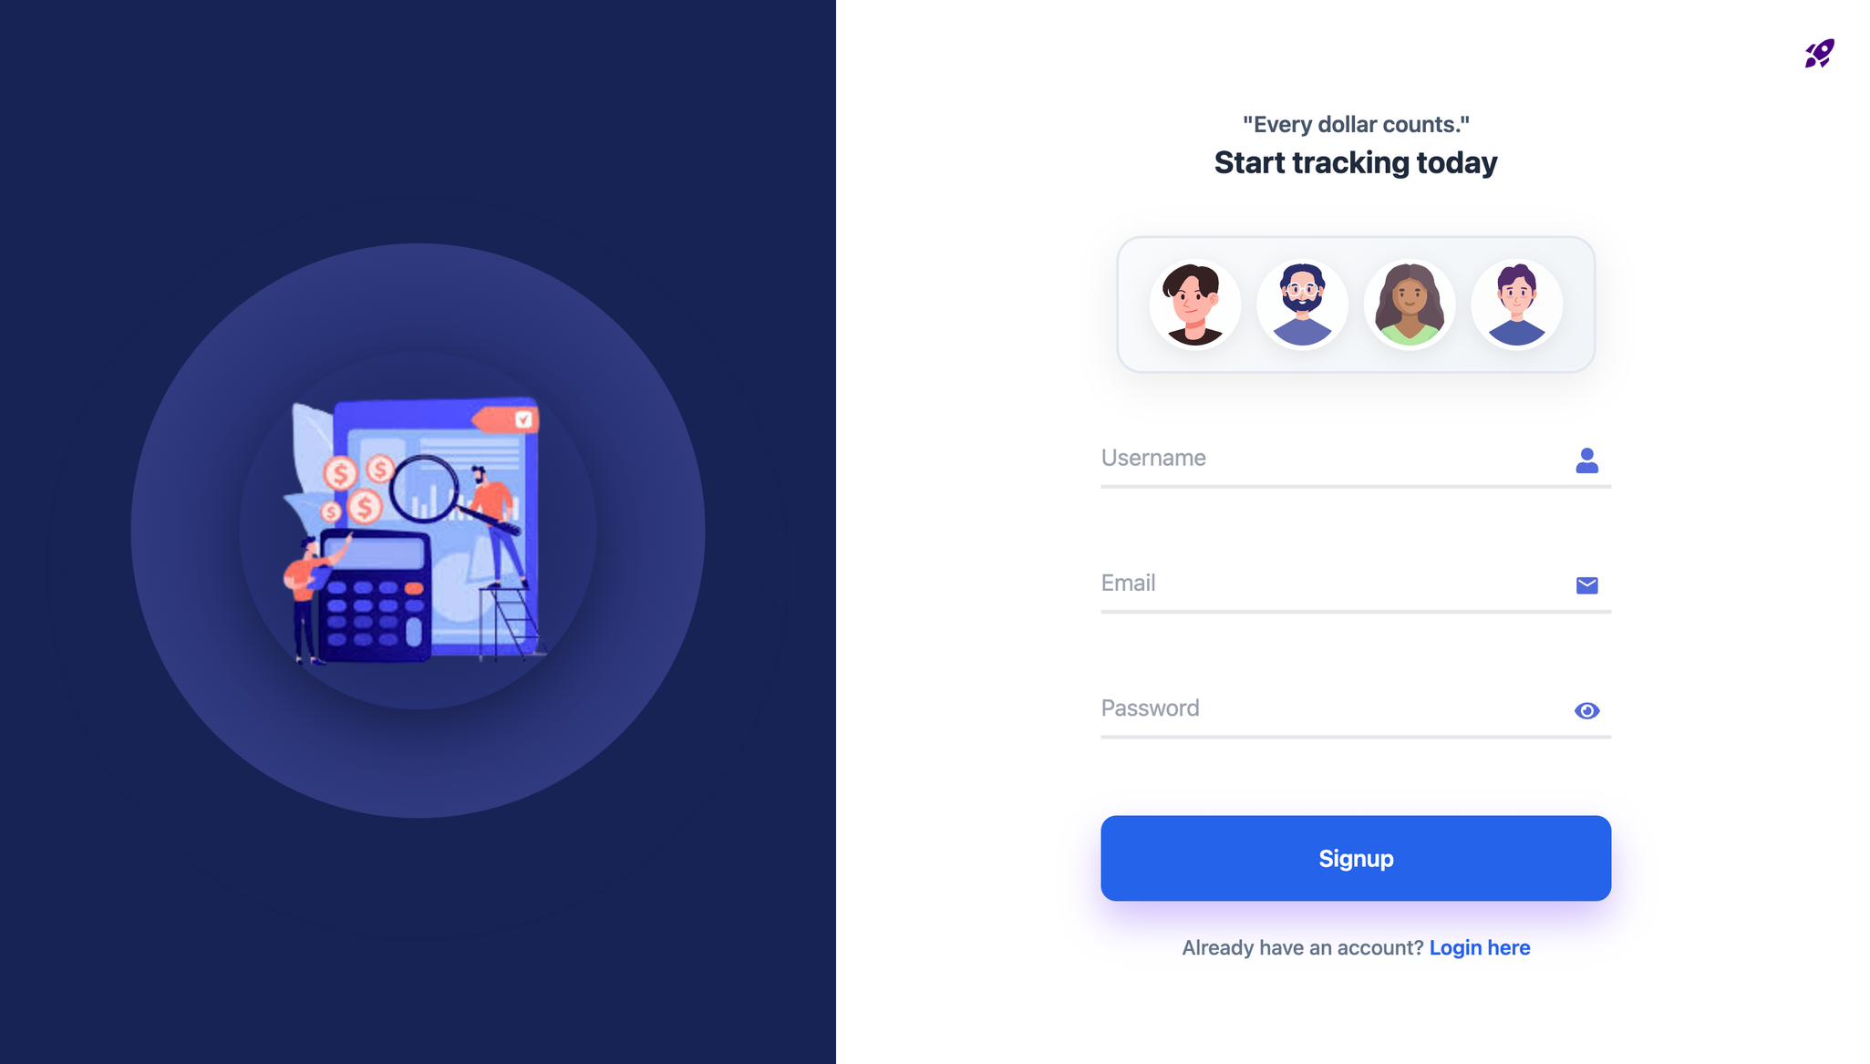
SIGNUP PAGE

Slide 12
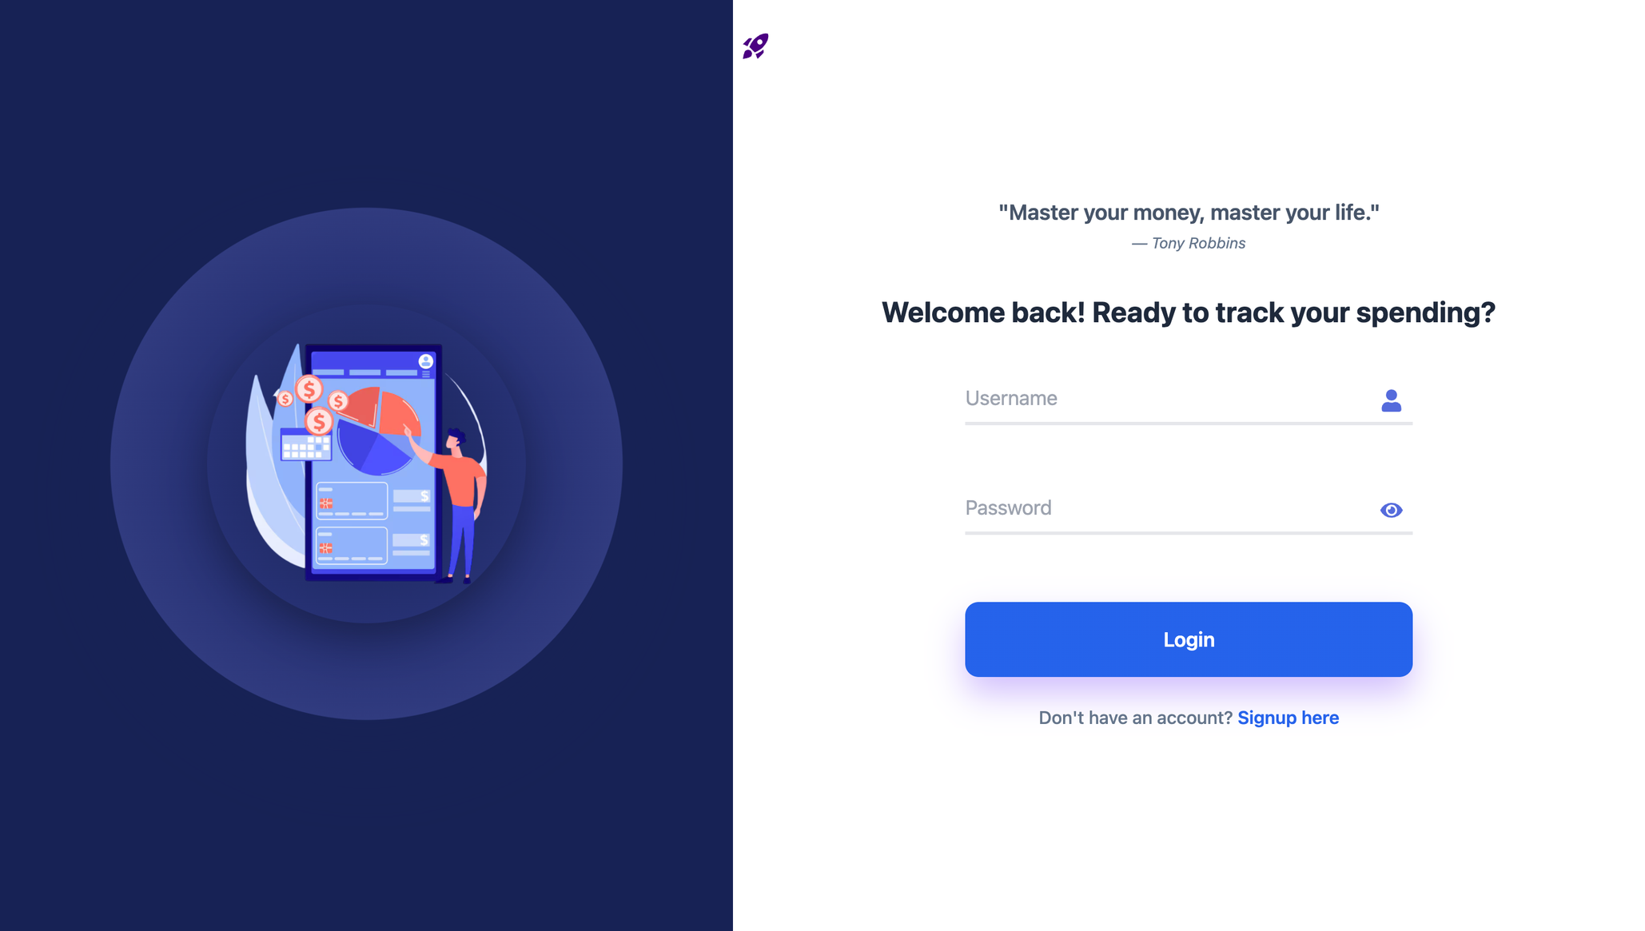
LOGIN PAGE

Slide 13
ANALYTICS DASHBOARD
PURPOSE
Visualizes expense and spending
Provides quick financial insights and summaries.
Helps identify patterns across time and categories.
TECHNICAL IMPLEMENTATION
Build with React Functional Components and Hooks.
Data managed using Redux state management.
Memoization used for performance optimization.
Dynamic calculations and aggregations from raw data.
Interactive charts rendered using Recharts
Graceful handling of loading and error states.
CORE FEATURES
Year and month based filtering.
KPI summary (total, average, transactions, categories).
Monthly expense trend visualization.
Category-wise expense distribution.
Category spending comparison.
Daily spending pattern analysis.

Slide 14
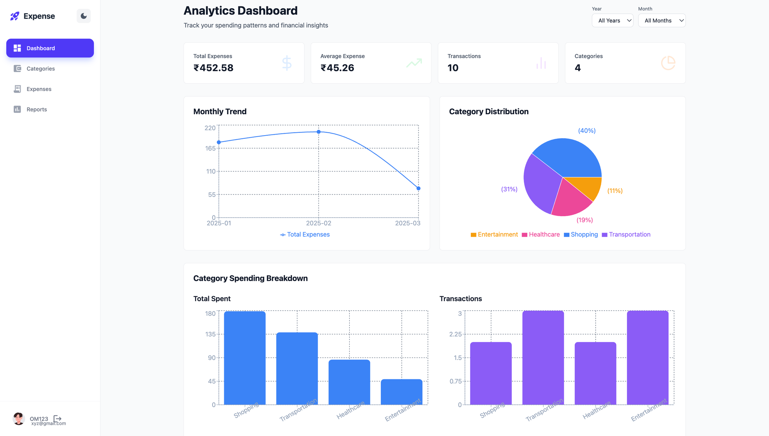
DASHBOARD PAGE

Slide 15
CATEGORY MANAGEMENT INTERFACE
PURPOSE
Organizes expenses into structured groups
Improves expense tracking clarity
Enables category-wise reporting and analysis.
TECHNICAL IMPLEMENTATION
Built using React Functional Components with Hooks for efficient state management.
Implemented live search and conditional rendering for dynamic UI updates
Applied core concepts like state immutability, reusable modal, and form validation
CORE FEATURES
Create new categories
Edit existing categories
Delete categories (with confirmation)
Search categories instantly
Assign icons and colors dynamically

Slide 16
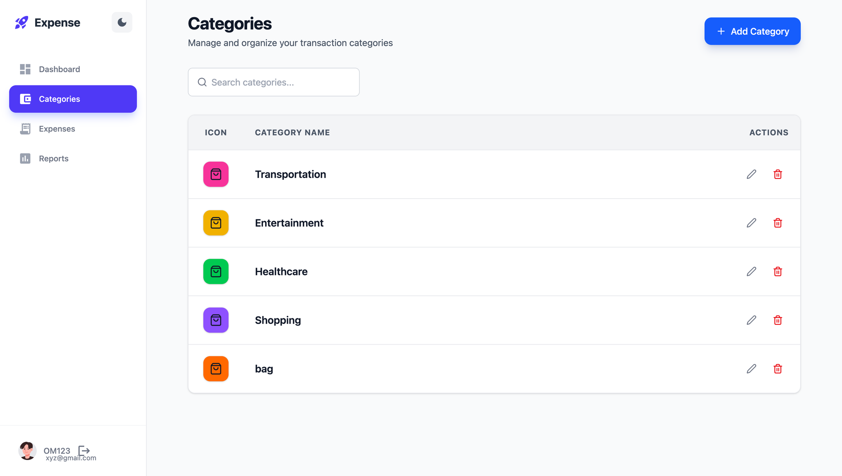
CATEGORIES PAGE

Slide 17
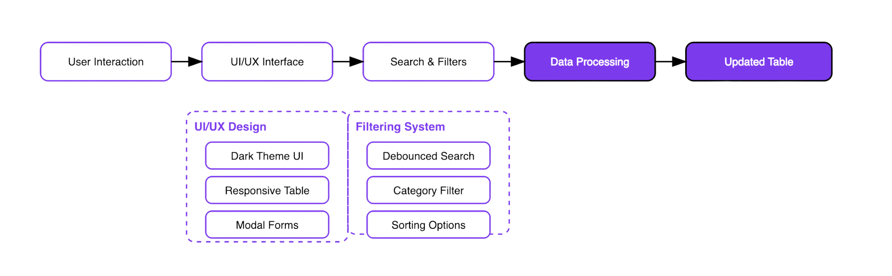
EXPENSES MANAGEMENT INTERFACE
UI/UX Design
Complete dark theme interface with Tailwind CSS
Responsive table layout & gradient summary cards
Modal forms (Add/Edit) with backdrop effects
Loading states & error handling displays
Search & Filter Features
Debounced search by title (500ms)
Category filter dropdown
Sort options: Amount (High/Low), Date (Newest/Oldest)

Slide 18
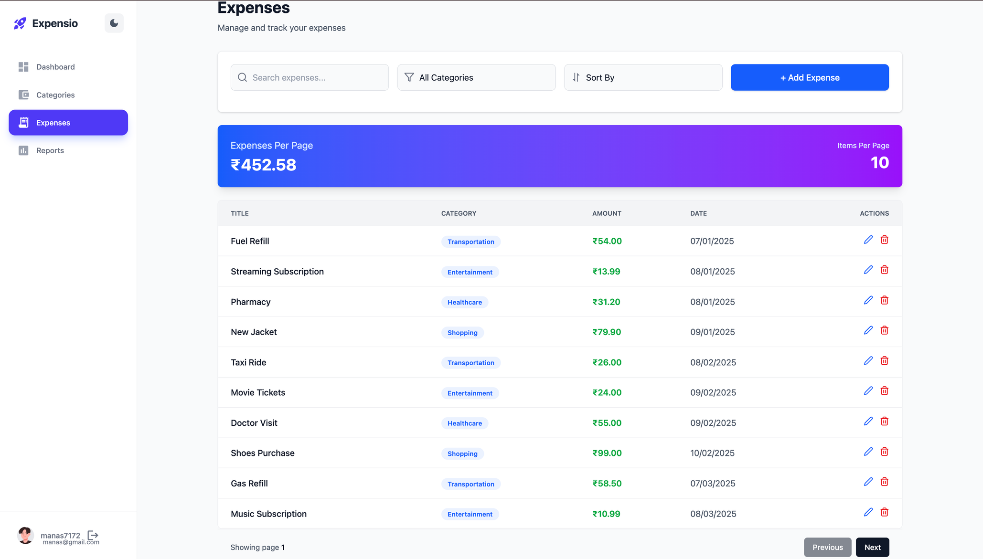
EXPENSES PAGE

Slide 19
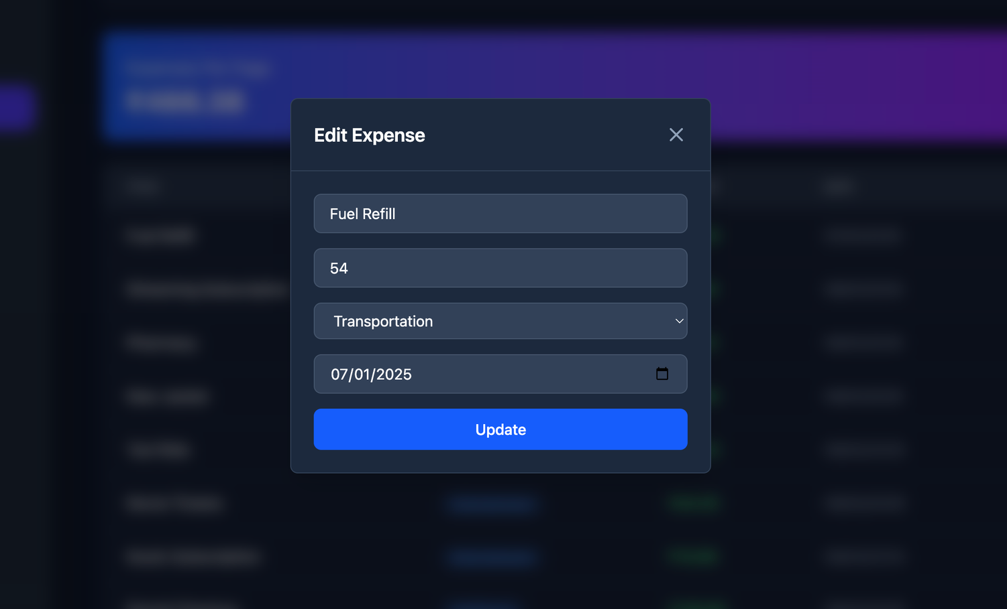
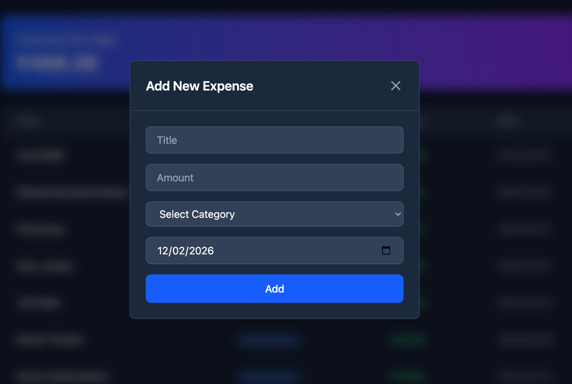
EXPENSES PAGE
EDIT EXPENSE
ADD EXPENSE

Slide 20
REPORTS GENERATION
Purpose
Provide a consolidated view of all expense transactions
Enable users to analyze spending patterns
Offer summarized insights for better financial tracking
Key Features
Expense Summary Dashboard - Displays total transactions, total amount spent, and latest transaction date
Smart Search & Advanced Filters - Filter by category, month, year, and amount range to quickly find specific expenses
Sorting Options - Sort expenses by date (Ascending / Descending).
CSV Download - Export expense data for reporting or external use
Performance Optimization
Improved application speed and overall performance
Enhanced page loading experience
Optimized data processing for better efficiency
Improved search responsiveness
Optimized rendering for large datasets

Slide 21
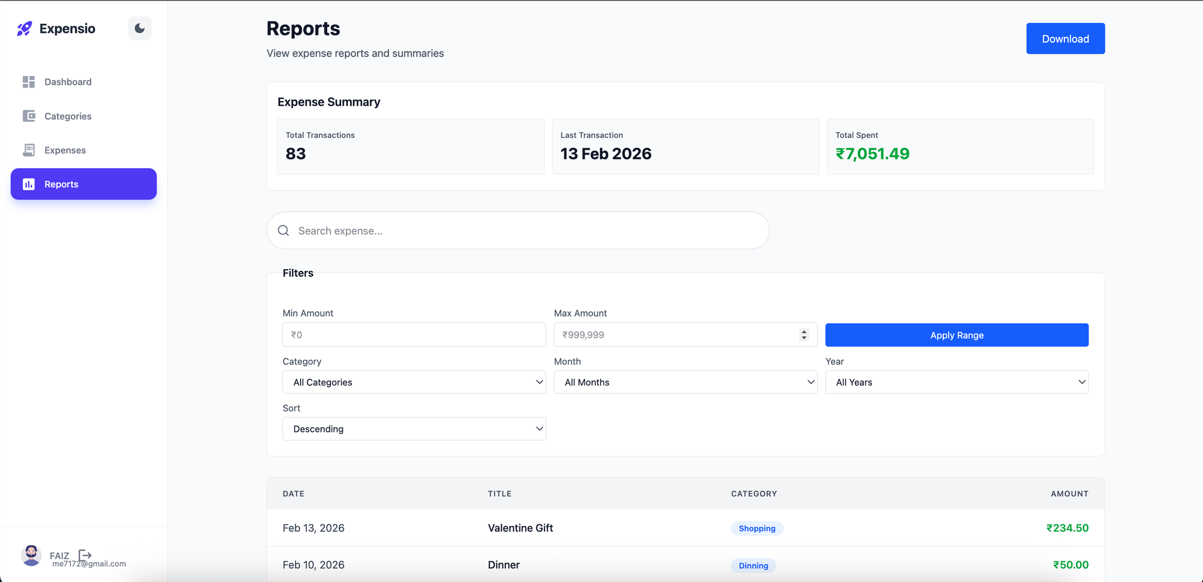
REPORTS PAGE

Slide 22
PERFORMANCE OPTIMIZATION
2. Memoization
• useMemo for expensive calculations
• React.memo for component optimization
• Memoized Redux selectors
1. Debouncing
• Search input debounced to 500ms
• Reduces unnecessary API calls
• Improves user experience
3. Redux Optimization
• Normalized state structure
• Selective re-rendering
• Efficient state updates
4. Code Splitting
• Lazy loading components
• Dynamic imports
• Reduced initial bundle size
5. Other Optimizations
• Throttling for scroll events
• Minimal re-renders
• Efficient list rendering with keys

Slide 23
ADDITIONAL FEATURES IMPLEMENTED
✓ Amount range filtering (min/max)
✓ Multiple sort options (amount & date)
✓ Real-time total calculation
✓ Responsive modal forms
✓ Delete confirmation dialogs
✓ Loading spinners
✓ Error messaging
✓ Clean and modern UI design
✓ Dark theme interface
✓ Icons for better UX
✓ Form validation
✓ Auto-clear after range apply

Slide 24
GROUP TAKEAWAYS
Full-Stack Integration: Connected React frontend with JSON Server backend for seamless data flow
Redux Mastery: Implemented Redux Toolkit for complex state management across modules
Performance Optimization: Applied debouncing, memoization, and throttling techniques
UI/UX Development: Created responsive, user-friendly interfaces using Tailwind CSS and React components
Team Collaboration: Learned to divide work, integrate modules, and deliver cohesive solution
Real-World Problem Solving: Translated business requirements into technical features

Slide 25
CONCLUSION
Successfully developed a fully functional Expense Tracker application with category management
Implemented modular architecture with two independent teams working on separate features
Integrated Redux for efficient state management across the application
Applied performance optimization techniques for smooth user experience
Strengthened understanding of component lifecycle, hooks, state management, and API integration
Successfully integrated concepts from the training program into a cohesive, real-world project

Slide 26
THANK
YOU

